Slide 1
Chapter 11 Circles

Slide 2
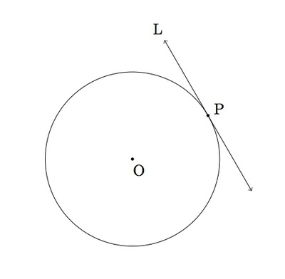
11-1 Tangent Lines
A tangent to a circle is a line in the plane of the circle that intersects the circle in exactly ONE point.
The point where a circle and a tangent intersect is the point of tangency.

Slide 3
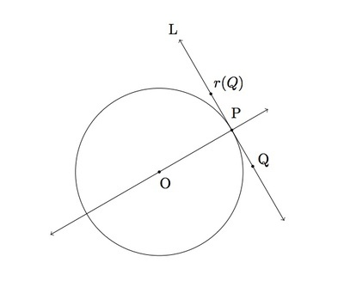
Theorem 11-1
If a line is tangent to a circle, then the line is perpendicular to the radius drawn to the point of tangency.

Slide 4
Example: ML and MN are tangent to Circle O. Find the value of x.

Slide 5
Example: ED is tangent to Circle O. Find the value of x.

Slide 6
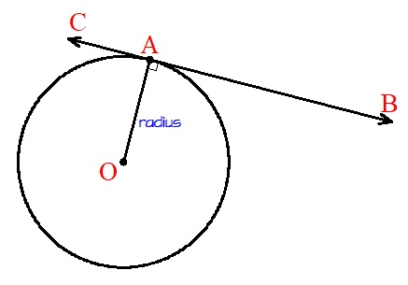
Theorem 11-2
If a line in the plane of a circle is perpendicular to a radius at its endpoint on the circle, then the line is tangent to the circle.

Slide 7
Example: Is ML tangent to Circle N at Point L? Explain

Slide 8
Theorem 11-3
The two segments tangent to a circle from a point outside the circle are congruent.

Slide 9
Example: Circle O is inscribed in Triangle ABC. Find the perimeter of Triangle ABC.

Slide 10
Example: Circle O is inscribed in Triangle PQR. Triangle PQR has a perimeter of 46. Find QY.
12
6

Slide 11
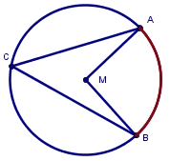
11- 3 Inscribed Angles
Inscribed angle – An angle is inscribed in a circle if the vertex of the angle is on the circle and the sides of the angle are chords of the circle.
Intercepted arc – An intercepted arc is an arc of a circle having endpoints on the sides of an inscribed angle, and its other points in the interior of the angle.

Slide 12
Theorem 11-9 Inscribed Angle Theorem
The measure of an inscribed angle is half the measure of its intercepted arc.

Slide 13
Example: Find the values of a and b.

Slide 14
Examples

Slide 15
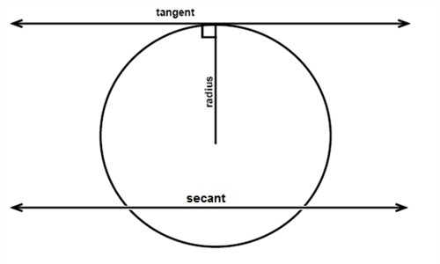
11-4 Angle Measures and Segment Lengths
A secant is a line that intersects a circle at TWO points.

Slide 16
Theorem 11-11
The measure of an angle formed by two lines that intersect INSIDE a circle is half the sum of the measures of the intercepted arcs.
Formula:

Slide 17
Theorem 11-11
The measure of an angle formed by two lines that intersect OUTSIDE a circle is half the difference of the measures of the intercepted arcs.
Formula:

Slide 18
Examples:
Find the value of each variable

Slide 19
Examples:
Find the value of each variable

